Slide 1
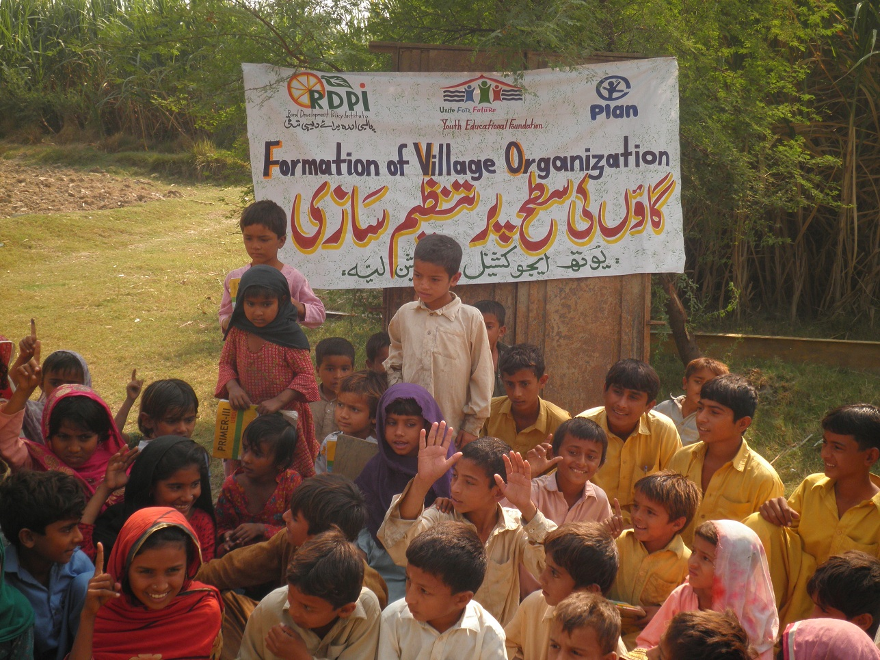
Youth Educational Foundation

Slide 2
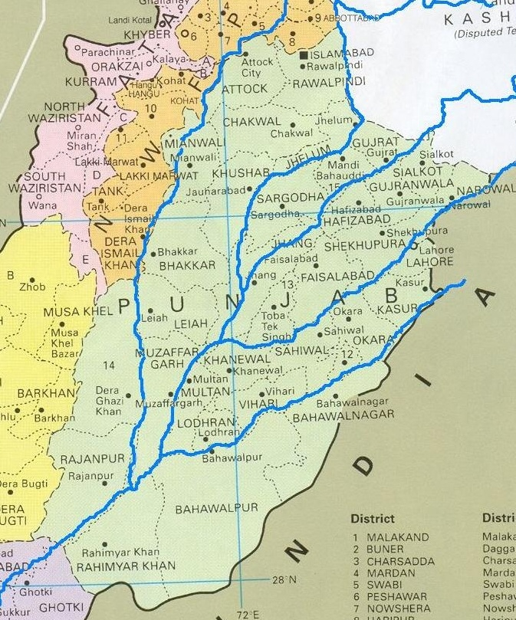
Geographical Coverage Punjab(Pakistan) Map

Slide 3
CONTACT INFORMATION
Contact Person | LAILA MUNIR KHAN
Head Office | Near_ District Population Office -Employees Colony Layyah
Phone Number: | Mobile: 0301-7847181, 03007483243
E-mail address: | yef@youthpk.org, lailakhan.saleem@gmail.com
Website: | www.youthpk.org
www.Youthpk.org

Slide 4
Vision
Local Youth raising voice for rights –Social justice to All

Slide 5
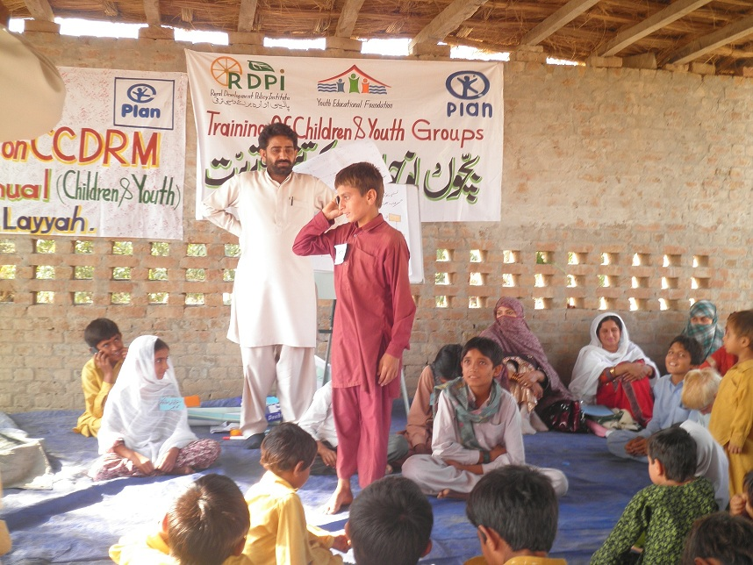
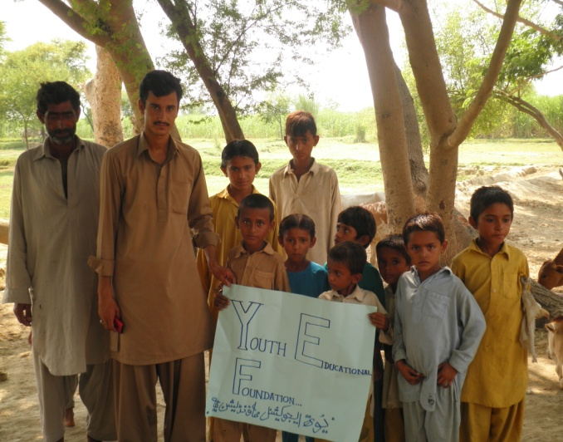
To organize local youth to raise their voice for rights
Education to All
To increase the capacity of local children and youth for Disaster Risk Management
Policy Advocacy –Awareness Raising up to International level
To enhance leadership qualities of local youth to become GOODCITIZENSHIP
To increase the livelihood options of targeted population
Best and balance use of available local resources-Local Self Reliance
Strong Linkages development with Governmental Agencies and Non Governmental Institutions
OBJECTIVES :

Slide 6
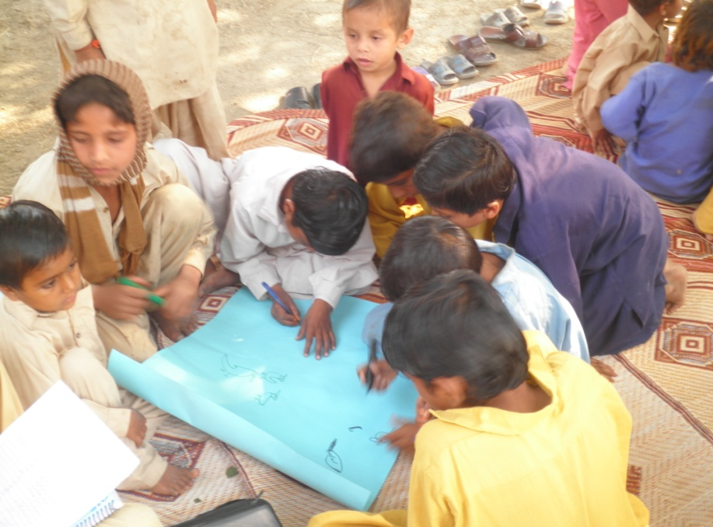
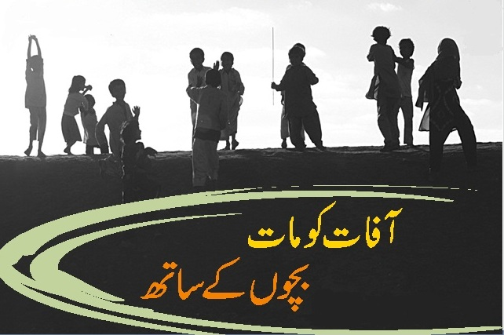
THEMATIC AREAS:
Youth Empowerment
Education
Child Protection
Environment
Sustainable Livelihood
Disaster Risk Reduction
Health
Emergency Relief
Advocacy & Lobbying
Vocational Skill Development
Water & Sanitation
Housing
Advocacy & Lobbying

Slide 7
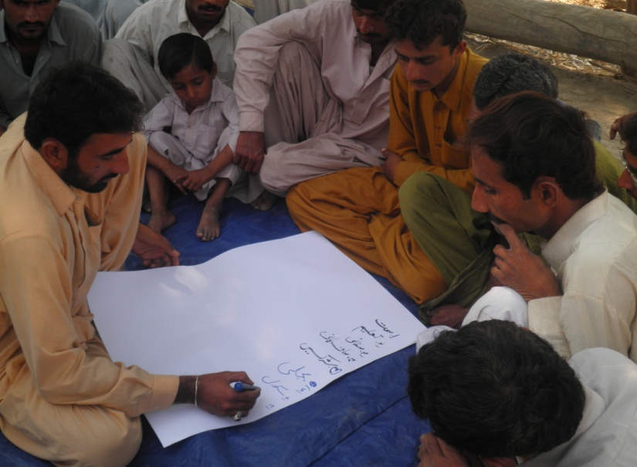
FOCUSED POPULATION
Children & Youth
Women
People with disabilities
Minorities
CBOs
Line Departments
Poorest of the poor (destitute)
Women headed/managed household (poor widow/orphans/divorced)
Land/ asset/shelter less families
Indigenous communities
Socially and politically marginalized communities
Small farmers having up to 05 acres of land

Slide 8
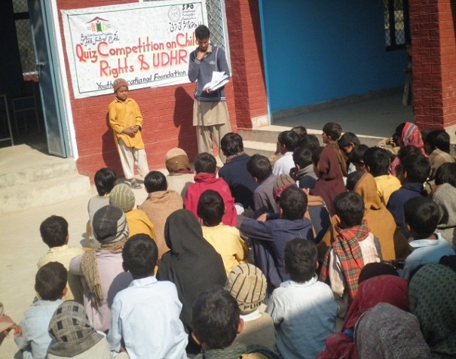
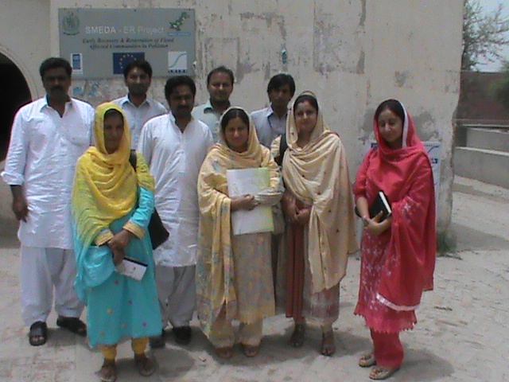
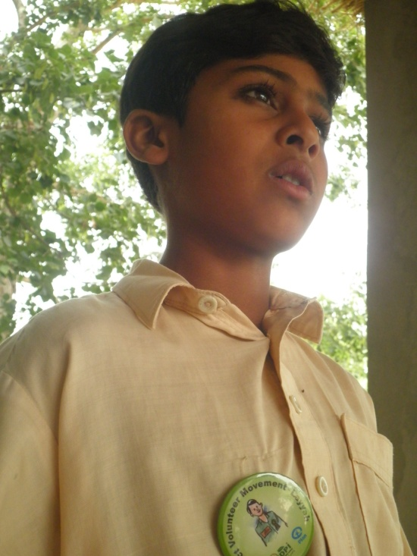
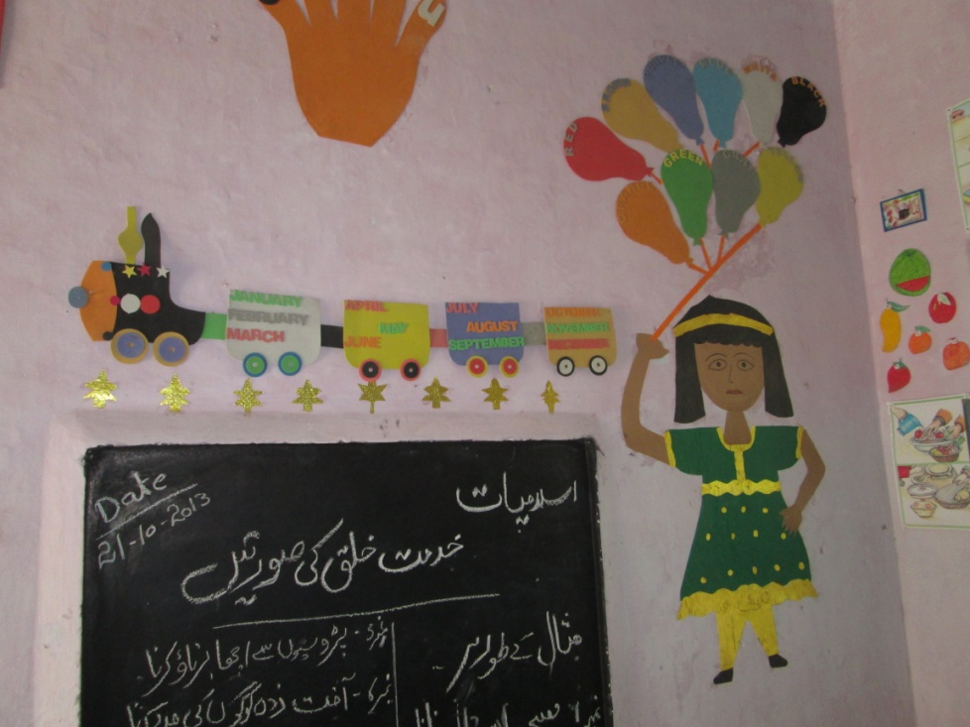
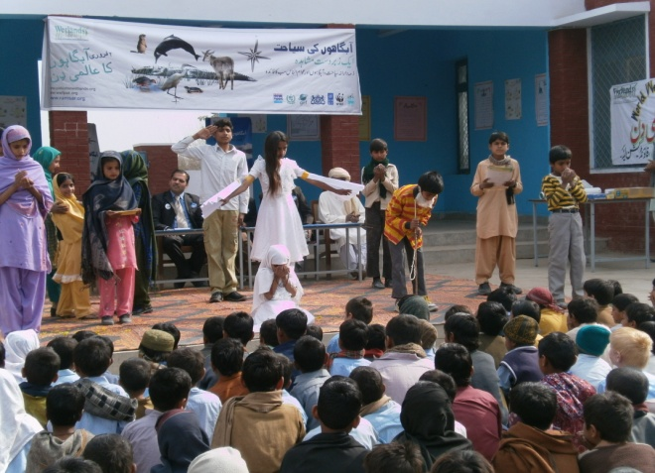
PARTNERS
Local Youth & Communities
MUSLIM CHARITY UK
FOCUS HUMANITARIAN ASSISTANCE
RDPI
PLAN INTERNATIONAL PAKISTAN
ECI
SMEDA
Avicenna Consulting
SPO
WWF

Slide 9
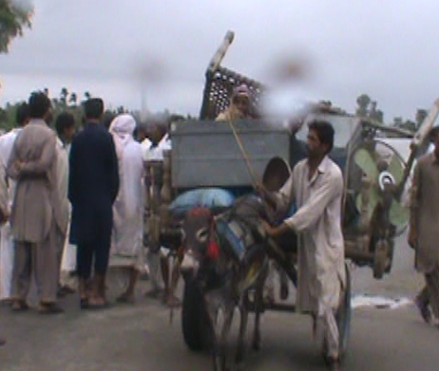
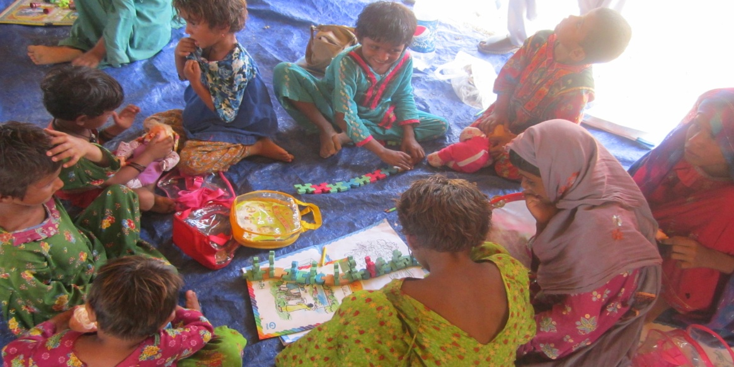
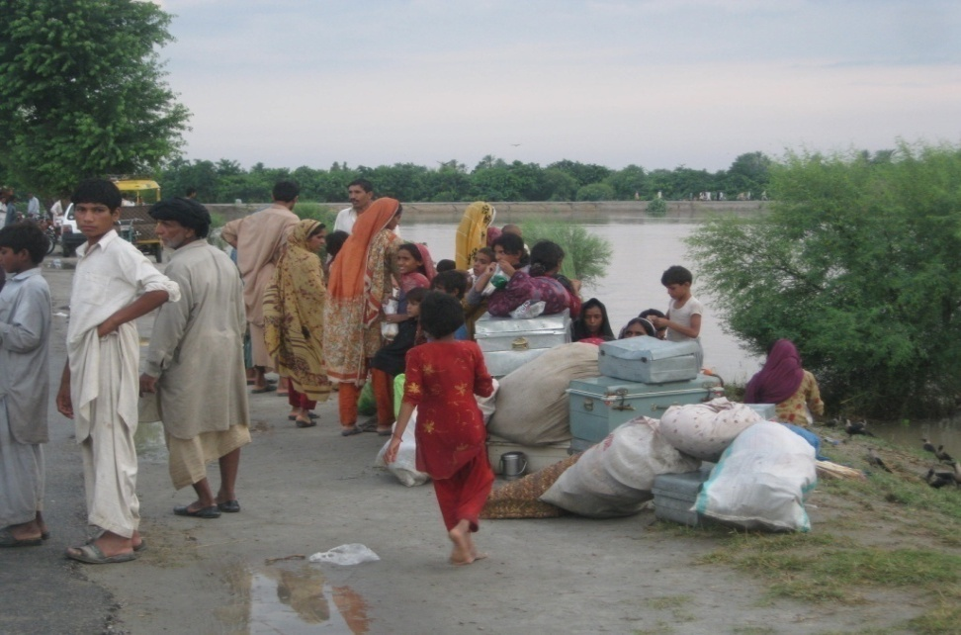
YOUTH PROGRAMS
FLOOD RESPONSE 2010
Search & Rescue
Free Medical Camps
Camp Registration
Distribution of cooked & Uncooked Food
NFIs
Public Health Promotion
Child Friendly Spaces

Slide 10
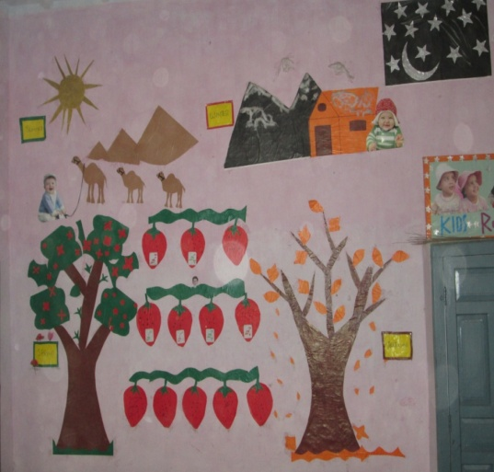
2. CHILD CENTERED DIASASTER RISK MANAGEMENT
Base Line of District Layyah & Rajanpur
Formation of Village Organization
Children & Youth Group Formation
Training workshop with children and youth on DRR & Child Protection
Training workshop with Elder(VOs) on DRR & Child Protection
Preparation of Village Development Plan
Preparation of Disaster Contingency Plans
Village Development Schemes/Micro Infrastructure
Training workshop of village organization on Disaster Effective Communication
Training Workshops of Children & Youth on Volunteerism and LMST
Community drills
Drawing competition of children and youth in schools on different and current issues.
Small structured Schemes

Slide 11
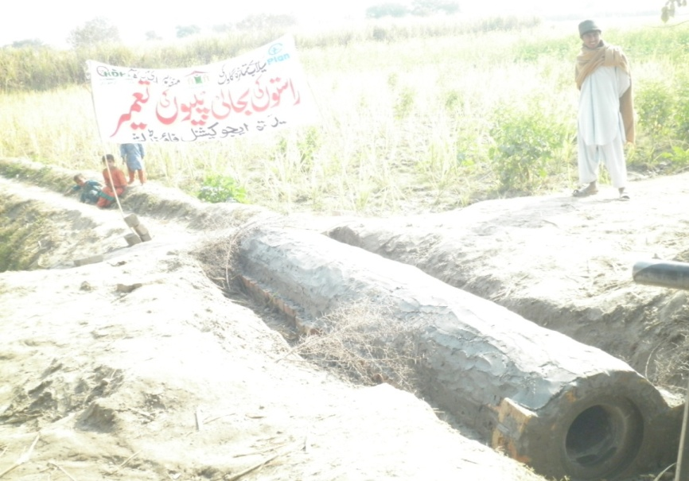
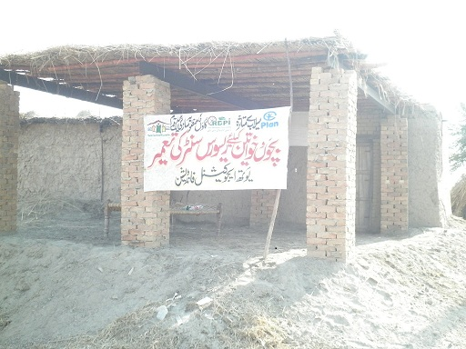
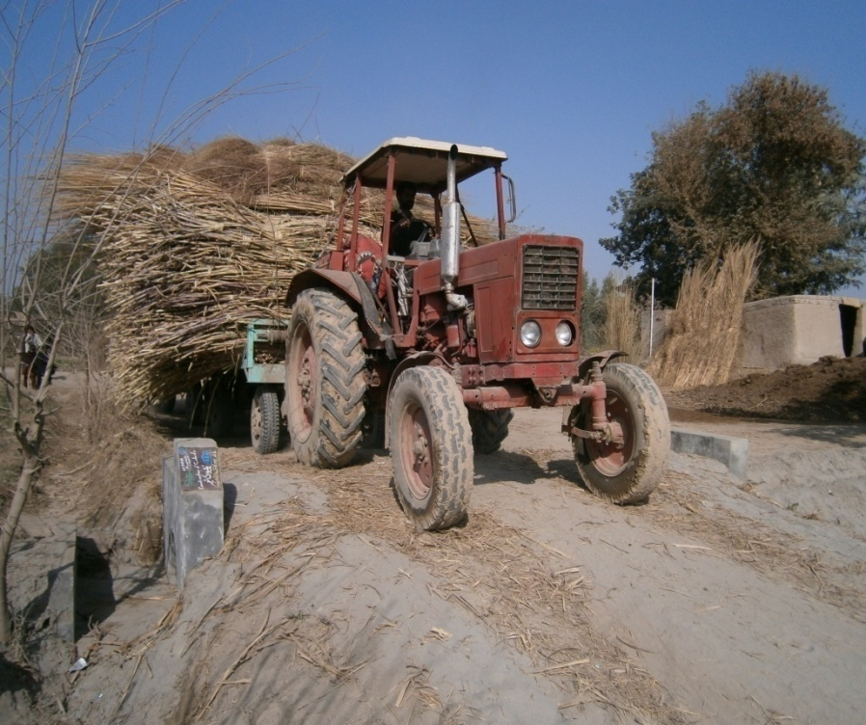
Structural Initiatives
Village Contingency Planning
Community Development Planning
Execution of CDP in term
Small Schemes
Community Contribution
Children Participation
Implementation of Cluster Schemes

Slide 12
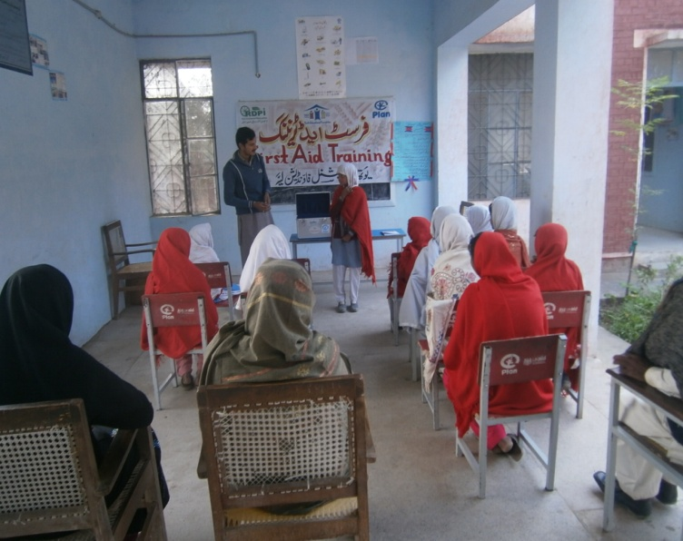
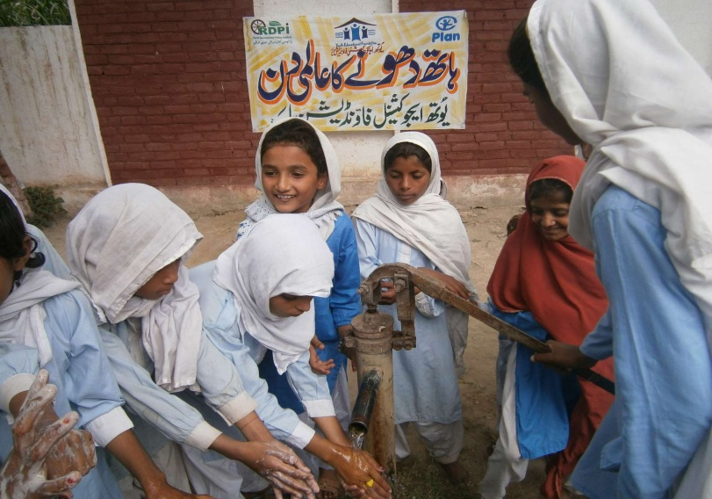
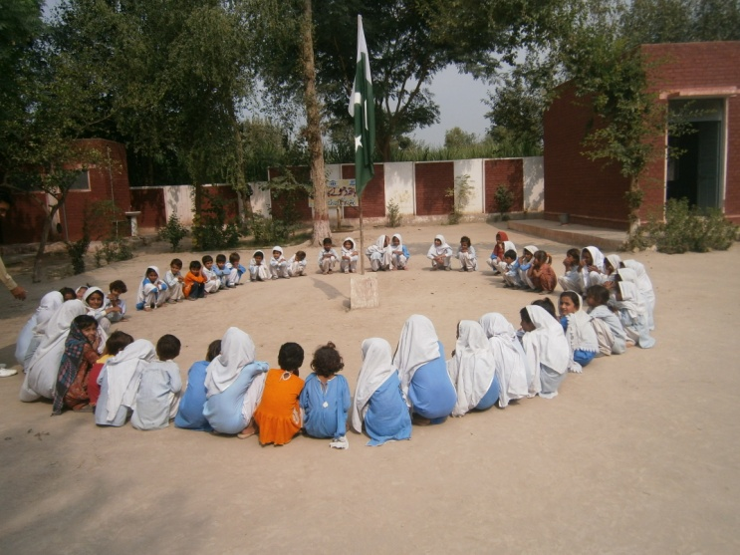
SAFER SCHOOL
Formation of School Representative Committees
School Safety Audit
Training on First Aid & School Safety
Provision of First Aid Kits
Preparation of School Safety Plans
Mock Drills

Slide 13
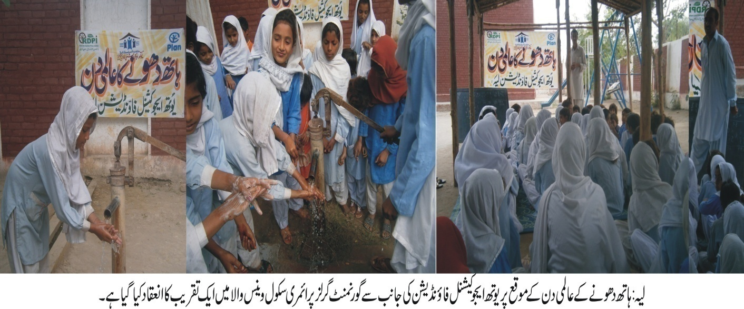
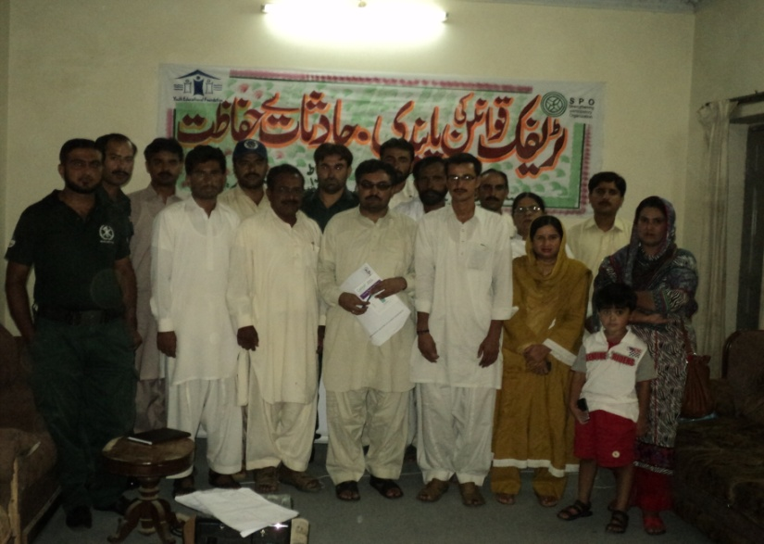
3.ADVOCACY & GOVERANCE
Advocacy Seminar on Sanitation Condition of Mohalla Eid Gah Layyah
Preparation of CNIC of Rural Women
Advocacy Seminar on “Acid Attack on Women”
Advocacy Seminar on Traffic Accident at TDA CHOWK Layyah
2 Consumer Protection Cases
Observation of International Women Day
Celebration of Global Hand Washing Day

Slide 14
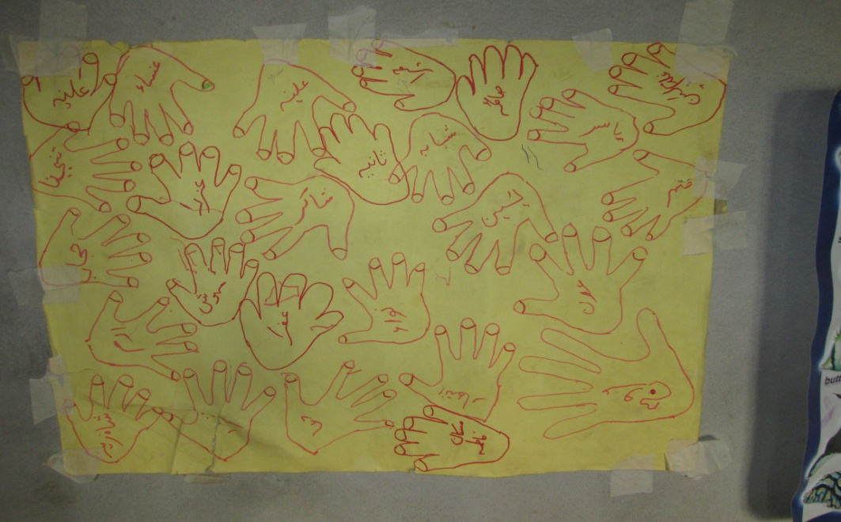
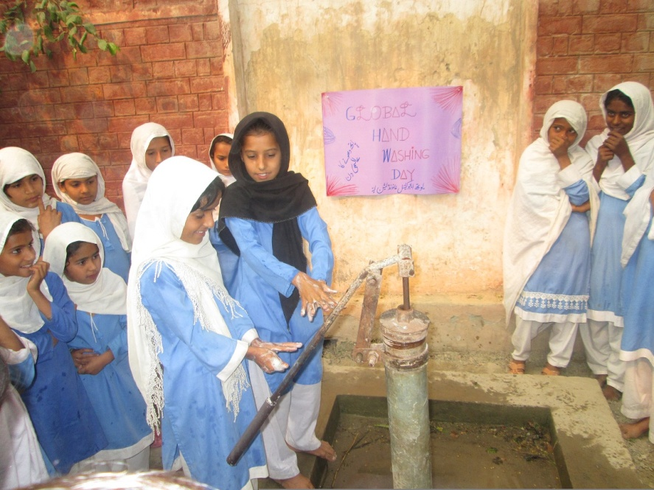
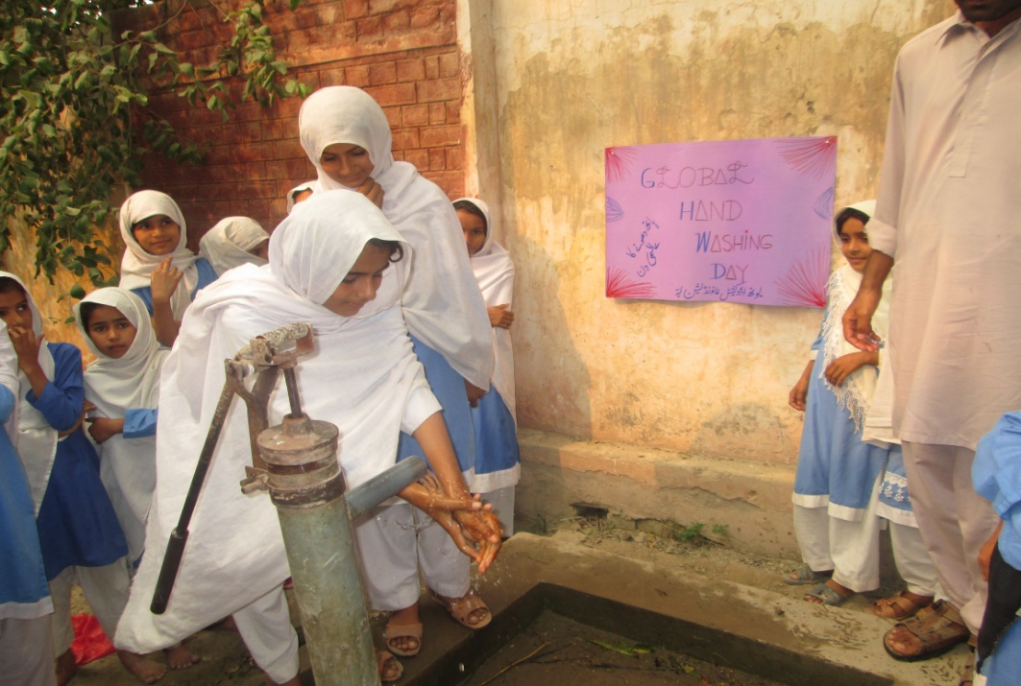
Celebration of Global Hand Washing Day 2013

Slide 15
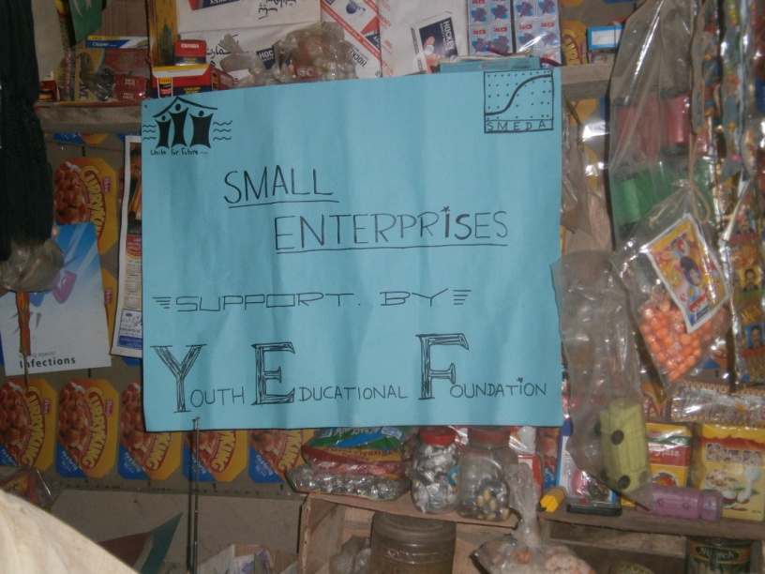
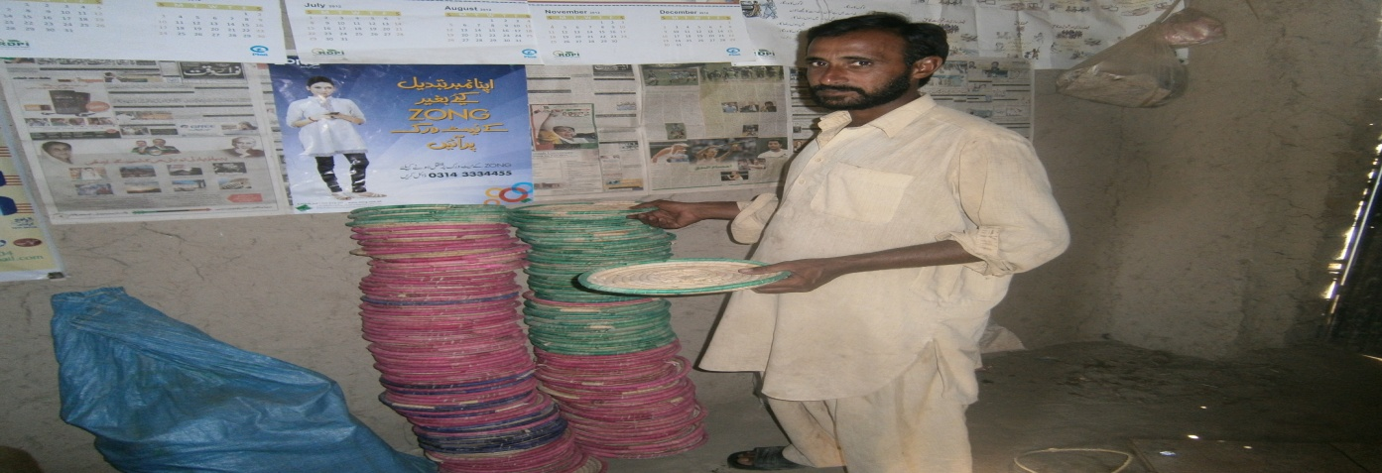
4. CAPACITY BUILDING OF COMMUNITY & SEs
6 Days TOT on strengthening of Associations
3 Days Organizational development for Sustainable Livelihood and Enterprises Development
8 Days Business Development Services for Sustainable Livelihood and Enterprises Development
Establishment of Micro Enterprises
Development of Milk Cooperative

Slide 16
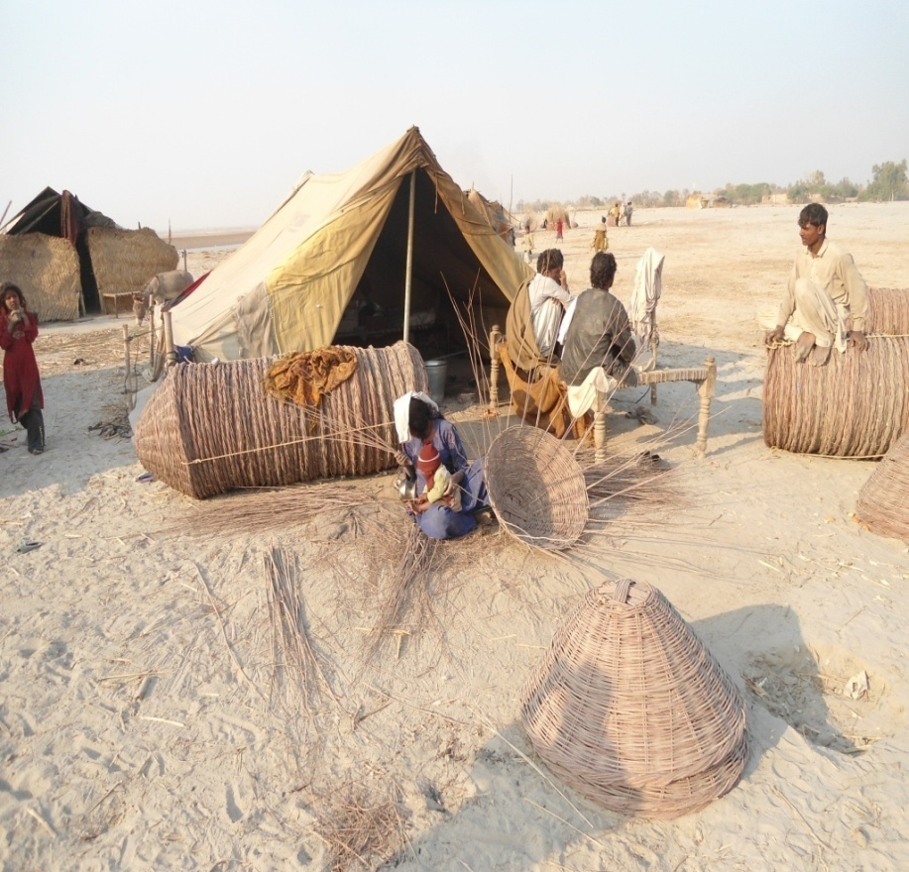
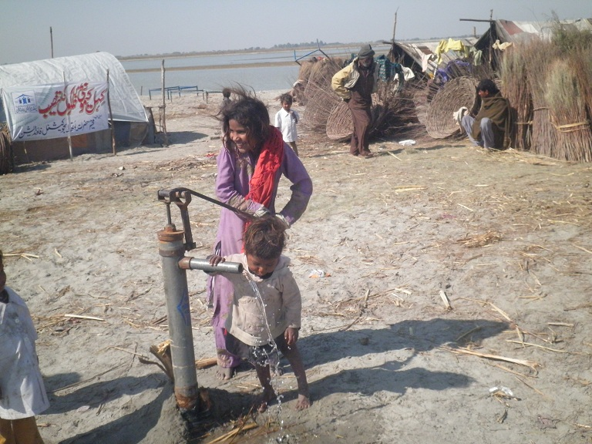
5.KEHIL SUPPORT PROGRAM
Market Linkage Development
Public Health Promotion
Provision of Safe Drinking Water
Child Education

Slide 17
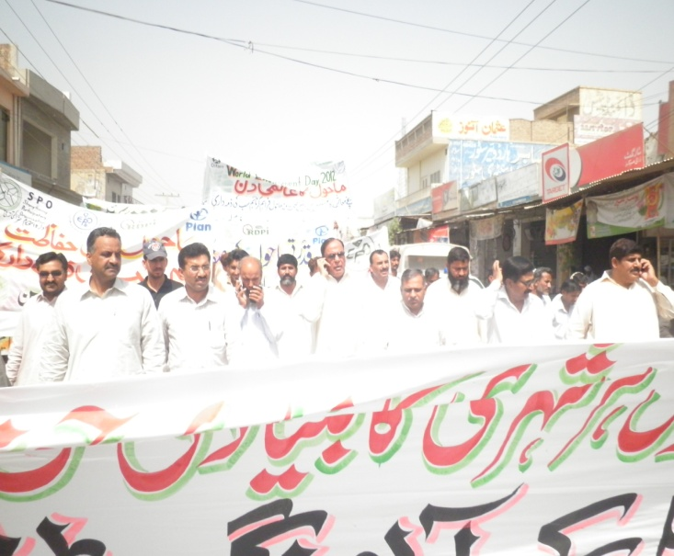
6.ENVIRONMENT CONSERVATION
Celebration of International Wetland Days
Eco Tourism-Taunsa
Establishment of Agro Forestry
Tree Plantation
Organic Farming
Celebration of Environment Days

Slide 18
Education to ALLLLLLLLLLLL
SAFE WATER PROJECT
YEF is working with the partnership of MUSLIM CHARITY UK under safe water program. It is going to install 150 hand pumps in 150 government schools of district Layyah
SAFER SCHOOL PROJECT
YEF is implementing a school safety project in 25 schools of district Layyah with the partnership of FOCUS HUMANITARIAN ASSISTANCE AND PLAN INTERNATIONAL PAKISTAN

Slide 19
Significant Changes(working on DRR & Education):
Community based Early Warning System
Strengthening of coordination(internal & external)
Increasing Sense of Ownership
Massive Increase in enrollment at schools
Children Participation/children are more confident
Impact on early marriages/decreasing trend
Linkages with departments
Contingency measures at community level
Participatory decision making
Right Based approach
Trained Volunteers on Emergency Management
Volunteers are part of District Contingency Plan
Evacuation Master Plan with Rescue 1122 and DDMA

Slide 20
Case Study
District Layyah is one of the underprivileged districts of South Punjab. It has three Tehsil and 44 Union Councils. It has very high poverty ratio and livelihoods options. People of that area depend upon agriculture and livestock, some of them working in field as unskilled labor. Out of 44 Union Councils, Shadoo khan is one of the poorest UC of tehsil Layyah.
Village Jarh Tahir Wali is one of poorest and having less opportunities for livelihoods of Union Council Shadoo Khan. It is 25 kilo meter away from district head quarter. Youth Educational Foundation started its intervention since 2010. Community has formed their CBO, children and youth groups. Youth Educational Foundation has focused on community mobilization, capacity building on DRR and strengthening livelihoods options of community. Under its livelihoods strengthening component, it has established one micro level enterprise with support of community partners.
Aman Ullah is poor laborer living with hand to mouth. He used to think about his livelihood. In 2009 he established a small shop of kitchen items in his house. After a year he was at same condition. He discussed his feeling with Youth Team. Team took this idea and discussed this matter in their office meeting. They come to point that we should analysis the trend of livelihoods of community. One handicraft was very common in that area that was (Bread keeper locally called CHABI). Most of the outsider of that village used to purchase at low rate, 5 rupee for one unit and sell it in market at high rate, 9 rupees of one unit. He decided to do that business but get nominal profit from local producer.
Four to five occasions he purchased from community and sell in market but he cannot get reasonable profit. So he decided to leave this business. Main while Youth Educational Foundation’s member Laila Munir Khan get training from ECI_SMEDA project and leant a lot for livelihood enterprise development tools and techniques. She discussed with Aman Ullah about tools and techniques of business development and suggested to developed linkages with market. She also facilitates him with her staff for linkages development with local market. Aman Ullah and Youth staff went to market, assess market value of product and decide to get this product in bulk almost 300-500 quantity in a week. If he gets only one rupee on one unit, he can get 300-500Rs. Next time he purchased one unit @ cost of 8 rupee and sell it @ cost 9 rupees. Aman Ullah is getting one rupee and community is getting 3 rupees more than that previous.
Now he is increasing his business, he used to bring Bread keeper from community and getting handmade fan from market, sell them in village at very nominal profit. “Aman Ullah said it is happening due to BAJI (Laila Munir Khan) facilitation regarding business techniques”. His livelihood is increasing due to the linkages with market and his socio-economic position and condition is improving. He has future plan; to increase his business and develop more linkages with market and related institutions.

Slide 21
Future Opportunities
Collaboration with Active Citizens Programs
Long Term Partnership with SPO
Long Term Partnership with RDPI & PLAN
Self Supportive Program with Community
Establishment of YOUTH COMMUNITY GIRLS MODEL SCHOOL

Slide 22
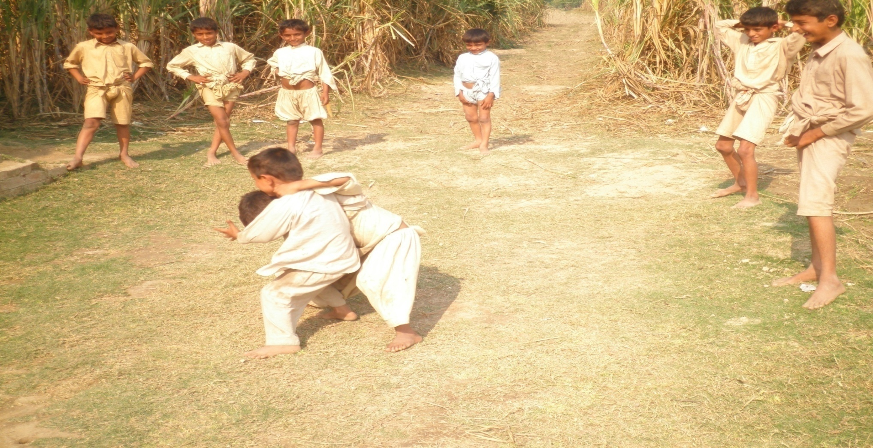
THANKS FOR PATIENCE
www.Youthpk.org

